Slide 2
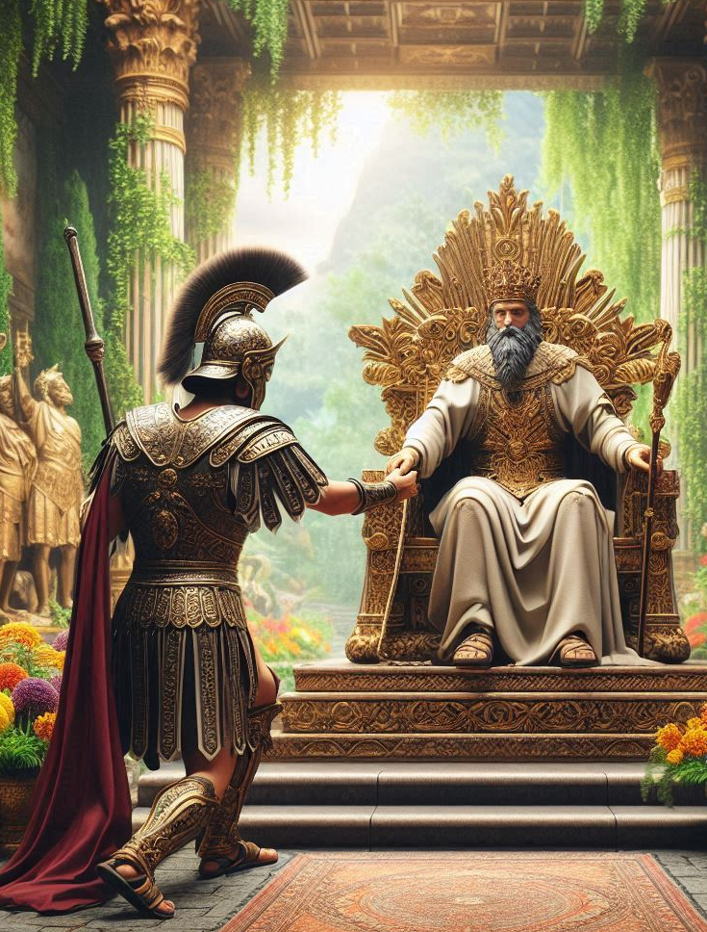
A Man Under Authority
Matthew 8:5-13 Matthew 28:18-20
Notes:
Jesus was amazed at the faith of a centurion who understood Jesus’ authority because he was also “A Man Under Authority.” Faith submits to authority. Christ has all authority, and those who are pursuing righteousness by faith will submit to His authority in every sphere of their lives.

Slide 3
Great Faith Respects Authority
A Centurian comes to Jesus on behalf of his servant (Matt. 8:5-13; Lk. 7:4-5).
He says he is “not worthy” for Jesus to come under his roof.
“Only speak a word, and my servant will be healed. For I also am a man under authority.”
Jesus declares: “I have not found such great faith, not even in Israel!”
Faith that obeys results in fellowship in the KINGDOM!

Slide 4
Jesus expresses His authority to and through His apostles
Matthew 28:18-20
And Jesus came and spoke to them, saying, "All authority has been given to Me in heaven and on earth. Go therefore and make disciples of all the nations, baptizing them in the name of the Father and of the Son and of the Holy Spirit, teaching them to observe all things that I have commanded you; and lo, I am with you always, even to the end of the age.”

Slide 5
Those pursuing righteousness will obey God’s commands
The commandments themselves are righteous (Psalm 119:138; 172).
Those who by faith obey the gospel’s commands are pursuing righteousness (Romans 6:16; 16:25-26).
We are under the law/authority of Christ! (1 Corinthians 9:20-21)

Slide 6
Humility and Submission: Key Components of being Under Authority
Humility enables one to respect authority; pride prevents it.
The Centurion (Matthew 8:8)
John the baptist (Matthew 3:11).
The apostle Paul (1 Corinthians 15:9).
David (Psalm 22:6 ; 2 Samuel 7:18).
Pride EXALTS self; it is the opposite of putting oneself UNDER another (1 Peter 5:5-6).

Slide 7
Under Authority: The Chain of Command
The Lord has set up chains of command covering many human relationships. Human relationships work best when God’s order is respected and maintained.
God → Christ → Man → Woman (1 Cor. 11:3)
God → Government → Citizens (Rom. 13:1-7)
God → Elders → Church (Hebrews 13:7, 17, 24)
God → Parents → Children (Eph. 6:1; Col. 3:20)
Submitting to authority in any of these relationships requires faith in God!

Slide 8
Under Authority: The Chain of Command
Christ has authority in all these relationships because He has ALL authority!
Christ is at the top of every chain of command!
He is “far above all principality and power and might and dominion, and every name that is named” (Eph. 1:19-23).
He is King of Kings and Lord of Lords! (1 Timothy 6:15)

Slide 9
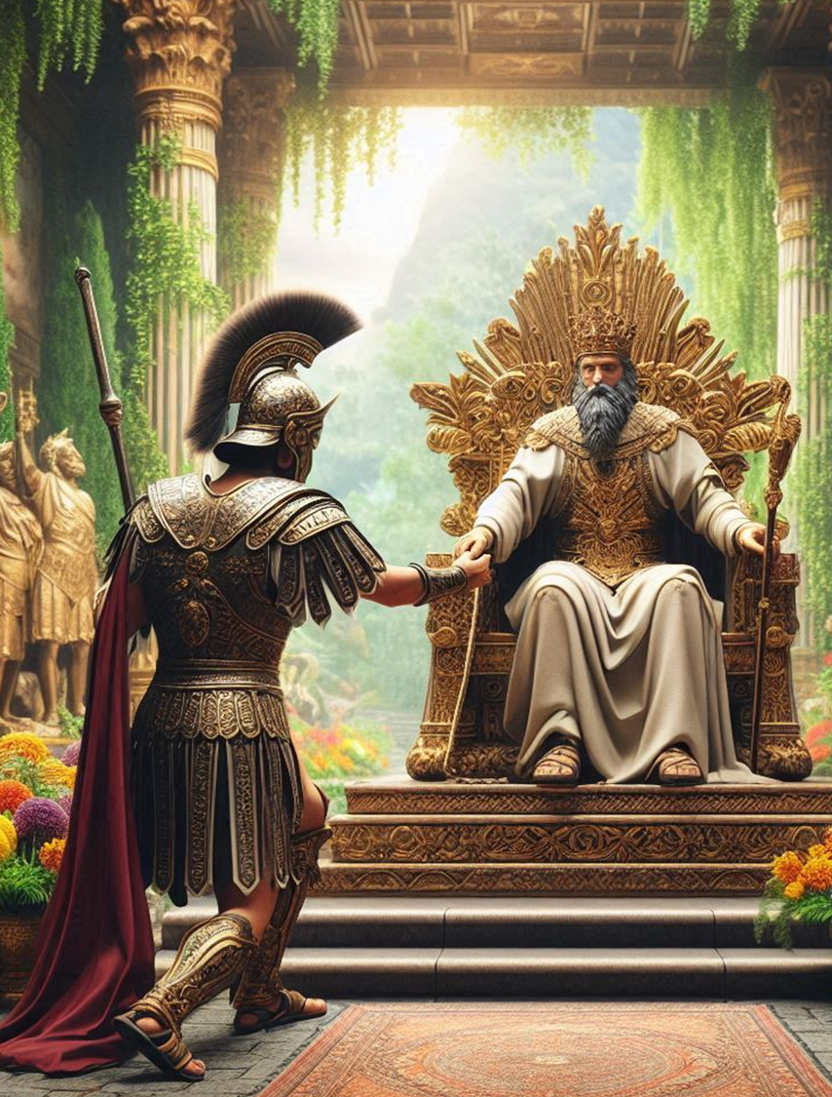
Faith finds its slot in the chain of command
By faith Abraham OBEYED
Hebrews 11:8 James 2:20-21

